Slide 1
national parks
A brief analysis of species in four national parks: Bryce, Great Smoky Mountains, Yellowstone and Yosemite

Slide 2
Analysis overview
We performed an analysis using two documents that provided species’ scientific names, common names, the number of observations within four different national parks, the category of each species and the conservation status of each species. This analysis primarily focuses on the number of species across parks as well as the conservation status of species.
We combined the two documents into a single table and identified a total of 5,824 species and their number of observations within each national park. The data was then reorganized to more easily view the number of observations for each species across each national park.
Of the 5,824 species listed, only 191 species were identified as either ‘Endangered,’ ‘Threatened,’ ‘Species of Concern,’ or ‘In Recovery.’ Most species were not provided a conservation status.
A few of the species were listed multiple times, such as the canis lupus, or gray wolf.

Slide 3
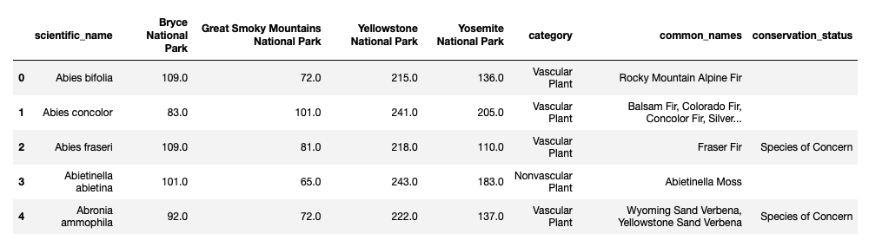
Table of data used for analysis
The first few entries of our data collection:

Slide 4
Observation summary
The following table provides a few insights into each national park. Least and most observations refer to the number of observations per species. These observations correlate with the species listed below. Total observations is the total number of observations for every species within the specified park.
National Park | Bryce | Great Smoky Mnt. | Yellowstone | Yosemite
Least observations | 9 | 10 | 57 | 31
Species | Corydalis aurea | Collomia tinctoria | Grus americana | Noturus baileyi
Category | Vascular plant | Vascular plant | Bird | Fish
Common name(s) | Golden Corydalis | Staining Collomia | Whooping Crane | Smoky Madtom
Most observations | 176 | 147 | 321 | 223
Species | Valerianella radiata | Sonchus asper | Lycopodium | Ivesia shockleyi
Category | Vascular plant | Vascular plant | Vascular plant | Vascular plant
Common name(s) | Corn Salad | Spiny Sowthistle | Ground Cedar | Sky Mousetail
Total observations | 576,205 | 431,820 | 1,443,562 | 863,332

Slide 5

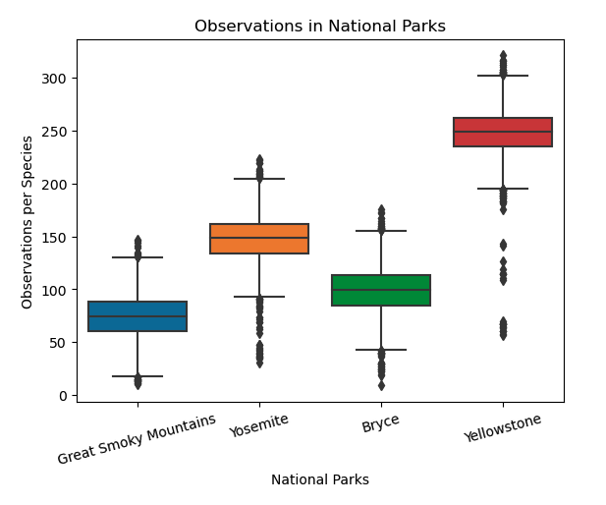

Observations of species in parks
Average number of times each species was observed in each park

Slide 6

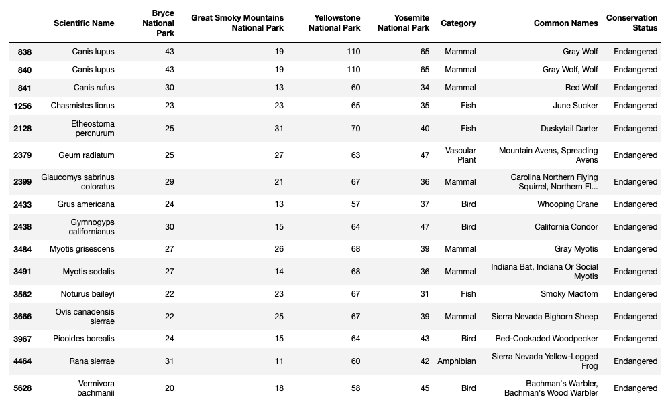

endangered species

Slide 7
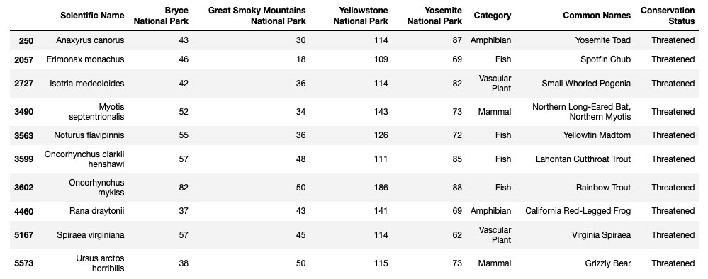
List of threatened species

Slide 8
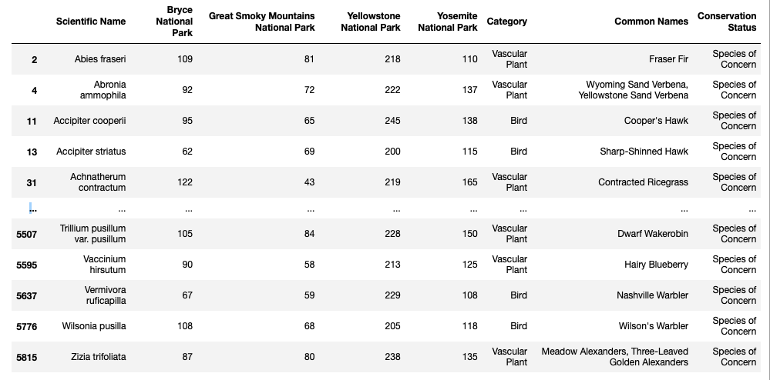
Species of concern
Table displaying some of the species listed as ‘Species of Concern’ :

Slide 9
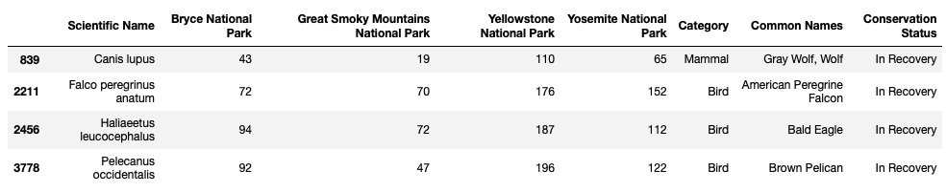
Species in recovery
Table displaying number of observations of species in recovery:
Evaluating the conservation status of each species shows that most endangered species are mammals, most species of concern are birds, and most species listed in recovery are birds. Only ten species are listed as threatened and they are evenly distributed across several categories.

Slide 10
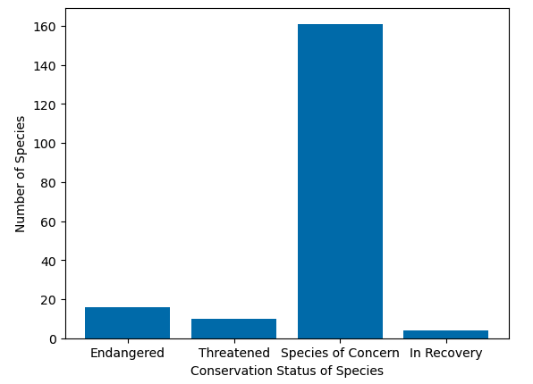
Species’ conservation status
Number of species listed with a conservation status:
16 Endangered Species
10 Threatened Species
161 Species of Concern
4 Species in Recovery

Slide 11
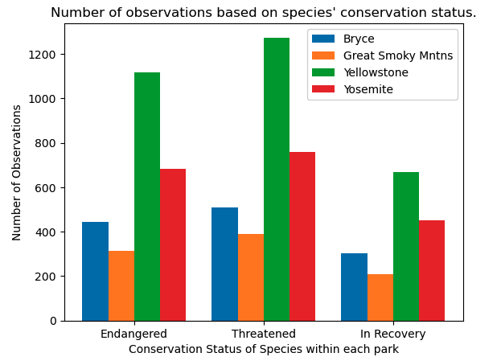
Species that are threatened, endangered or in recovery
Evaluating only those species listed as ‘Endangered,’ ‘Threatened,’ or ‘In Recovery,’ our totals show anywhere from around 200 to 1200 total observations across each of the four national parks.

Slide 12
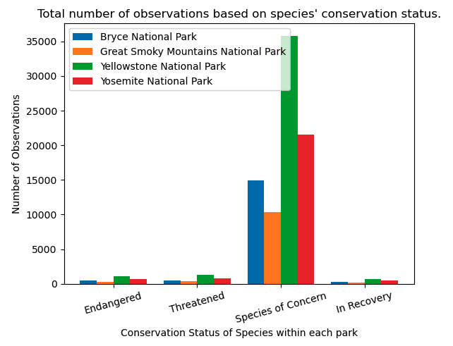
Observations of species based on conservation status
In summary, we don’t have enough data to evaluate the conservation status of most of the species. However, we can see that most observations took place in Yellowstone National Park while Great Smoky Mountains National Park had approximately a third the number of observations as Yellowstone. Evaluating the conservation status of species within each park shows a similar trend with Yellowstone having approximately a total of 35,000 observations and Great Smoky Mountains having a total of approximately 10,000 observations.

